Slide 1
TEAM
ANKIT PAHUJA (S5)
MAYANK BHOTIKA (S3)
DADI PADMAKARA SRINIVAS (S4)
ANMOL JOSHI (S6)
ABHISHEK PAL (S6)
SHIKSHA SWARAJ (S7)

Slide 2
Text Search Engine
Mentor: Prof Vijayant Pawar

Slide 3
RATIONALE OF THE WORK
Algorithmic complexity can further be reduced with right choice of data structures and algorithms when processing.
Search Engines today (Google) works on only one principle “Relevance”. But, Is Google’s search engine perfect - means completely relevant?
Demonstration

Slide 4
OBJECTIVES
Build all necessary systems that a search engine has in order to show your query results:
Crawling Technology
Indexing
Ranking and Scoring
Searching & Displaying top 10 results

Slide 5
HISTORY AND NOTABLE SEARCH ENGINES [1]
1990: Archie Query Form
1993: Primitive Web Search
1994: Yahoo! (David Filo and Jerry Yang)
1996: BackRub (Google’s Begining)
1998: MSN Search
1998: GOOGLE
2009: Bing (Re-branding of MSN Search)
2011: Schema

Slide 6
REVIEW OF LITERATURE
Analysis on Search Engines: Techniques and Tools [2]
Google: A Case Study (Web Searching and Crawling) [3]
Page Rank Algorithm and it’s Variations [4]

Slide 7
Analysis of Search Engines: Search Tools and Techniques [2]
Types of Search Engines:
Crawler Based
Human Powered Directories
WEB Crawling
Focused Crawling
Distributed Crawling

Slide 8
Indexing
Full-Text Indexing
Human Indexing
Search Engine Optimization (SEO) Techniques
Directory Submission
Keyword Research & Generation
Link Building

Slide 9
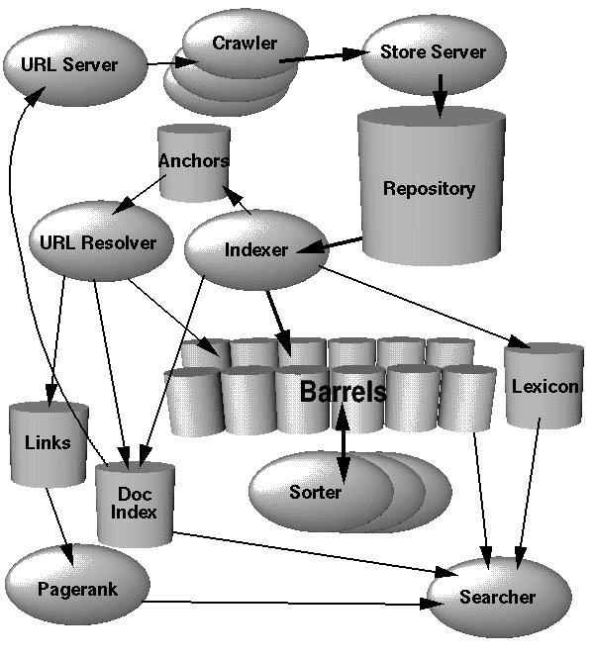
Google - A Case Study [3]
About Google’s Search Engine
Google’s Architecture

Slide 10
Other Google’s Features:
Crawling: follows (Link the Link Model)
Indexing: 10⁷ GB (2017) data in their index
Ranking and Scoring:
Page Rank
Keyword Density, Presence of Synonyms
Authority and trust of pages which refer to a page
Presence of keyword in Meta Information

Slide 11
Search Engines: Market Share
Google: 81%
Yahoo: 12%
MSN: 3%
ASK: 1%

Slide 12
[4] Page Rank Algorithm
PR(A) = (1-d) + d (PR(Ti)/C(Ti)+…….+PR(Tn)/C(Tn))
PR(A) = Page rank of the page A
PR(Ti) = PR of pages Ti which link to page A
C(Ti) = Number of outbound links on page Ti
d = Damping factor (0 to 1)

Slide 13
Info: PR Algorithm Analysis
Page rank = numerical number | initially is 1.
More the value, better the rank.
When introduced, was a major factor in deciding ranks in search window.
After 2013, Google discontinued sharing their changes in PR Algorithm.

Slide 14
METHODOLOGY
Everything that a Search Engine does:
Crawling
Indexing
Ranking & Scoring
Searching & Displaying Top 10 RELEVANT Results

Slide 15
CRAWLING TECHNOLOGY
Requests Library
Beautifulsoup (Tree Traversal)

Slide 16
INDEXING TECHNOLOGY
Inverted Index - Data Dictionary (Python)
Output:
{Word: doc_id: {pos1,pos2….posN}}

Slide 17
RANKING AND SCORING
TF - IDF Ranking Systems (Simpler)
Page Rank Algorithm (too hard!)

Slide 18
SEARCHING
Boolean Search (AND, OR, NOT)

Slide 19
REFERENCES
[1] https://www.wordstream.com/articles/internet-search-engines-history
[2] R. Rubini, Dr. R. Manicka Chezian, “An Analysis on Search Engines: Techniques and Tools”, International Journal of Advanced Research in Computer and Communication Engineering, Vol. 3, Issue 9, September 2014
[3] Krishan Kant Lavania, Sapna Jain, Madhur Kumar Gupta, and Nicy Sharma, “Google - A Case Study (Web Searching and Crawling)”, International Journal of Computer Theory and Engineering, Vol. 5, No. 2, April 2013
[4] Kaushal Kumar, Abhaya, Fungayi Donewell Mukoko, “PageRank algorithm and its variations: A Survey report”, IOSR Journal of Computer Engineering (IOSR-JCE), e-ISSN: 2278-0661, p- ISSN: 2278-8727 Volume 14, Issue 1 (Sep. - Oct. 2013), PP 38-45

Slide 20
Questions?
We are open to Questions and Suggestions!

